Slide 1
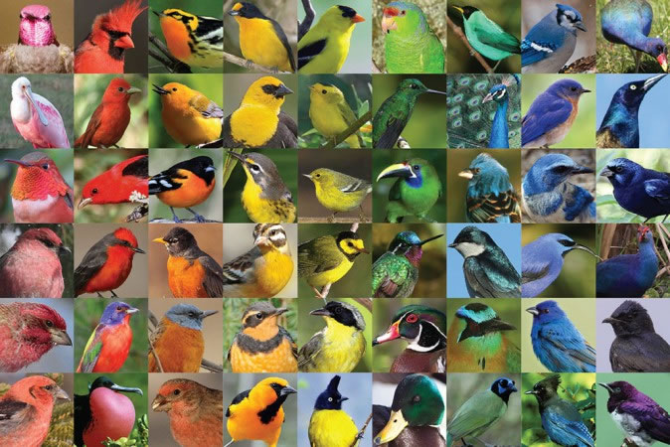
TOPIC : COLOUR PIGMENTATION IN BIRDS
INTRODUCTION :
Biological pigments are also known as simlpy as pigments & biochromes
They are substance produced by living organisms that have a coloufull resulting from selective colourfull absorption.
Biological pigments includes plant pigments and colourfull pigments in birds.

Slide 2
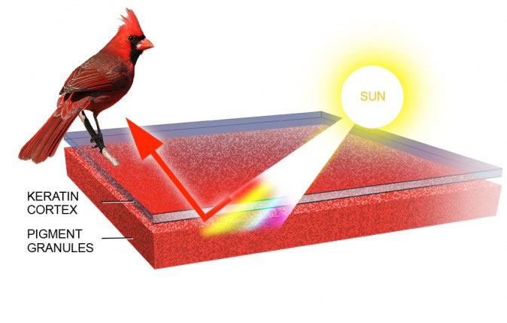
HOW BIRD’S FEATHERS ARE COLOURFUL??
Amazing diversity of colors and patterns exhibited by more than 9000 bird species found in the world.
The colours in the feathers of birds are formed in two different ways :
i: pigments ii: light refraction.
PIGMENTATION
Pigments are colored substance that can be found in both plants and birds.
The coloration created by pigments is independent of the structure of the feathers.
Pigment colorization in birds comes from 3 different groups: carotenoids, melanins, porphyrines.

